Slide 1
Test Automation & Advanced Selenium
Lesson 4: Selenium 2.0 – Web Driver

Slide 2
Lesson Objectives
Introduction To Web Driver
Web Driver Vs Selenium RC Vs Selenium IDE
Benefits of Web Driver over Selenium IDE and RC
Limitations of Web Driver

Slide 3
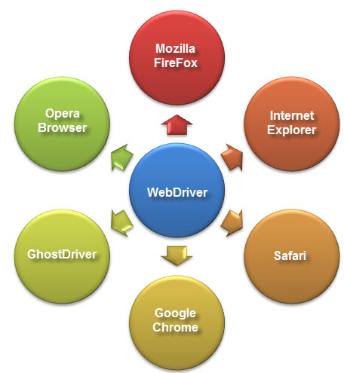
4.1: Selenium 2.0 – Web Driver Introduction To Web Driver
Web automation framework that allows you to execute your tests against different browsers, not just Firefox (unlike Selenium IDE).
Provides a simpler, more concise programming interface
Selenium-WebDriver was developed to better support dynamic web pages where elements of a page may change without the page itself being reloaded
Supply a well-designed object-oriented API that provides improved support for modern advanced web-app testing problems.

Slide 4
4.1: Selenium 2.0 – Web Driver Web Driver Vs Selenium RC Vs Selenium IDE
WebDriver
Supports all browsers like Firefox, IE, Chrome, Safari, Opera etc.
Supports Record and playback
Doesn’t required to start server before executing the test script
Interacts natively with browser application
As compared to RC, it is bit complex and large API.
Selenium RC
Supports all browsers like Firefox, IE, Chrome, Safari, Opera etc.
Doesn’t supports Record and playback
Required to start server before executing the test script.
Core engine is JavaScript based
It is easy and small API
Selenium IDE
Only works in Mozilla browser
Doesn’t supports Record and playback
Doesn’t required to start server before executing the test script.
Core engine is JavaScript based
Very simple to use

Slide 5
4.1: Selenium 2.0 – Web Driver Benefits of Web Driver over Selenium IDE and RC
Architecture is simpler than Selenium RC's
Faster than Selenium RC
Interacts with page elements in a more realistic way
API is simpler than Selenium RC's
Support the headless HtmlUnit browser
Notes:
1. Architecture
WebDriver's architecture is simpler than Selenium RC's.
It controls the browser from the OS level
All you need are your programming language's IDE (which contains your Selenium commands) and a browser.
You first need to launch a separate application called Selenium Remote Control (RC) Server before you can start testing
The Selenium RC Server acts as a "middleman" between your Selenium commands and your browser
When you begin testing, Selenium RC Server "injects" a Javascript program called Selenium Core into the browser.
Once injected, Selenium Core will start receiving instructions relayed by the RC Server from your test program.
When the instructions are received, Selenium Core will execute them as Javascript commands.
The browser will obey the instructions of Selenium Core, and will relay its response to the RC Server.
The RC Server will receive the response of the browser and then display the results to you.
RC Server will fetch the next instruction from your test script to repeat the whole cycle.

Slide 6
Notes:
2. Speed
WebDriver is faster than Selenium RC since it speaks directly to the browser uses the browser's own engine to control it.
Selenium RC is slower since it uses a Javascript program called Selenium Core. This Selenium Core is the one that directly controls the browser, not you.
3. Real-life Interaction
WebDriver interacts with page elements in a more realistic way. For example, if you have a disabled text box on a page you were testing, WebDriver really cannot enter any value in it just as how a real person cannot.
Selenium Core, just like other Javascript codes, can access disabled elements. In the past, Selenium testers complain that Selenium Core was able to enter values to a disabled text box in their tests. Differences in API
4. API
Selenium RC's API is more matured but contains redundancies and often confusing commands.
For example, most of the time, testers are confused whether to use type or typeKeys; or whether to use click, mouseDown, or mouseDownAt. Worse, different browsers interpret each of these commands in different ways tool
WebDriver's API is simpler than Selenium RC's. It does not contain redundant and confusing commands.
5. Browser Support
WebDriver can support the headless HtmlUnit browser
HtmlUnit is termed as "headless" because it is an invisible browser - it is GUI-less.
It is a very fast browser because no time is spent in waiting for page elements to load. This accelerates your test execution cycles.
Since it is invisible to the user, it can only be controlled through automated means.
Selenium RC cannot support the headless HtmlUnit browser. It needs a real, visible browser to operate on.

Slide 7
4.1: Selenium 2.0 – Web Driver Limitations of Web Driver
Cannot Readily Support New Browsers
Since, WebDriver operates on the OS level
Different browsers communicate with the OS in different ways.
If a new browser comes out, it may have a different process of communicating with the OS as compared to other browsers
Has no built-in command that automatically generates a Test Results File
Have to rely on your IDE's output window, or design the report yourself using the capabilities of your programming language and store it as text, html, etc.
Selenium RC automatically generates an HTML file of test results

Slide 8
Summary
In this lesson, you have learnt
WebDriver is a tool for testing web applications across different browsers using different programming languages.
You are now able to make powerful tests because WebDriver allows you to use a programming language of your choice in designing your tests.
WebDriver is faster than Selenium RC because of its simpler architecture.
WebDriver directly talks to the browser while Selenium RC needs the help of the RC Server in order to do so.
WebDriver's API is more concise than Selenium RC's.
WebDriver can support HtmlUnit while Selenium RC cannot.
The only drawbacks of WebDriver are:
It cannot readily support new browsers, but Selenium RC can.
It does not have a built-in command for automatic generation of test results.
Notes:
Add the notes here.

Slide 9
Review Question
Question 1
Select which is NOT a feature of Web Driver
Architecture is simpler
Faster
API is complex
Supports all the browsers
Question 2: True/False
WebDriver can Readily Support New Browsers.
Question 3: Fill in the Blanks
WebDriver can support _________while Selenium RC cannot.

